Slide 1

Plan Price Prediction Multiple Listing Service (MLS)
Eyong

Slide 2

Objective & Methodology
Use MLS features set to predict the PLAN PRICE of listing
We have done some Exploratory Data Analysis (EDA)
We have used Random Forest Machine Learning model for prediction
Data preprocessing applied to make data neat and clean for analysis
The results were evaluated using Evaluation techniques, Error etc.
Actual Plan Price and Predicted Plan price were compared

Slide 3

Dataset Description
We have used 165027 records initially, due to redundancy, we have aggregated PLAN PRICE for duplicate listings
After aggregation, 51154 data points were used for training Model
A total of 16 MLS Variables including two engineered features i.e. Day of month and Month of year – in this way we use datetime variable apparently in the model

Slide 4
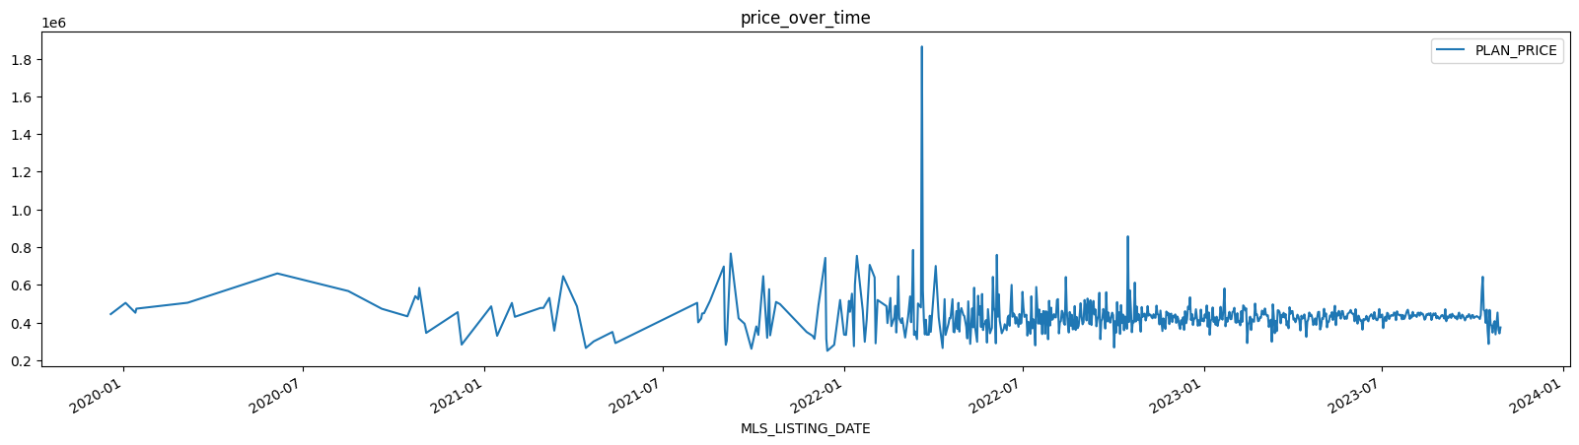
EDA

Slide 5
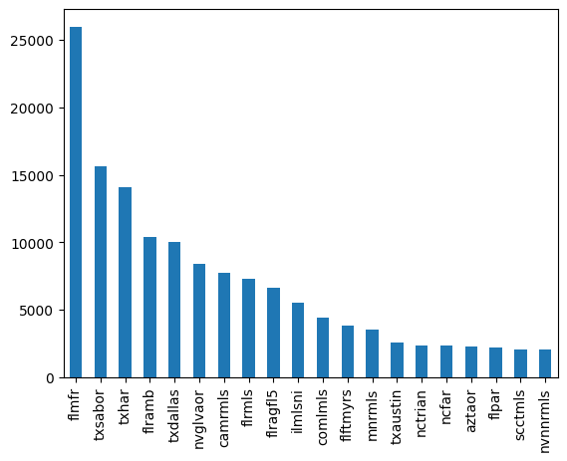
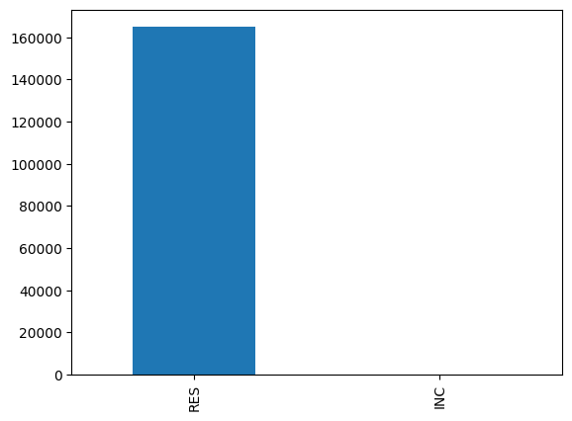
EDA

Slide 6
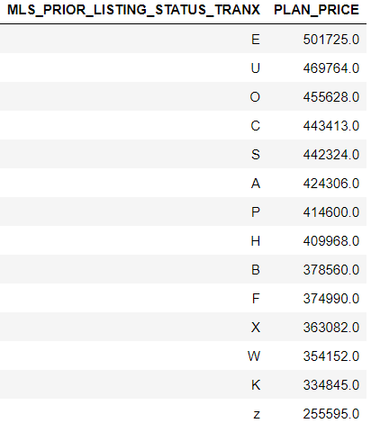
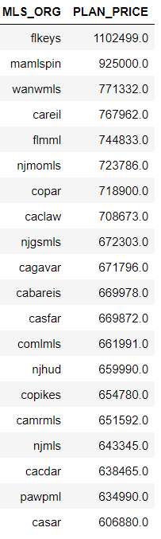
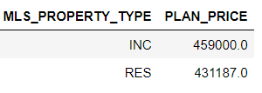
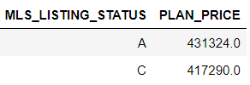
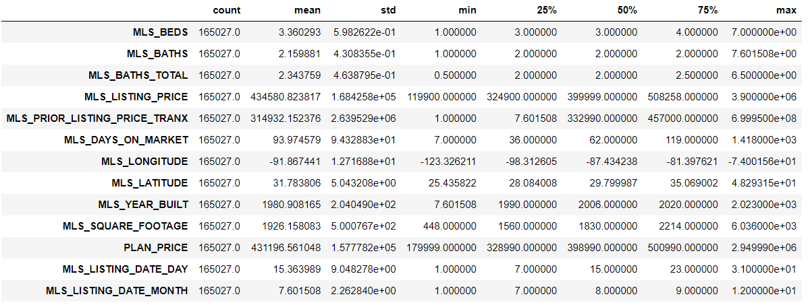
Average Prices for Categories

Slide 7
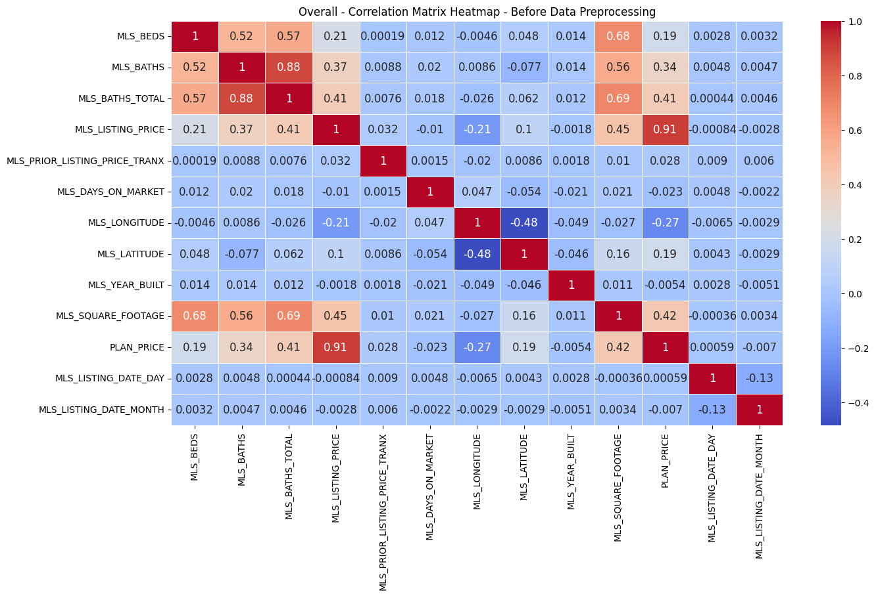
Feature Correlation
Based on these correlations, it's clear that MLS_LISTING_PRICE, MLS_SQUARE_FOOTAGE, MLS_BATHS_TOTAL, and MLS_BATHS have stronger relationships with PLAN_PRICE. You may consider these features as important factors when determining PLAN_PRICE. However, correlation doesn't imply causation, and further analysis is needed to build a predictive model for PLAN_PRICE.

Slide 8
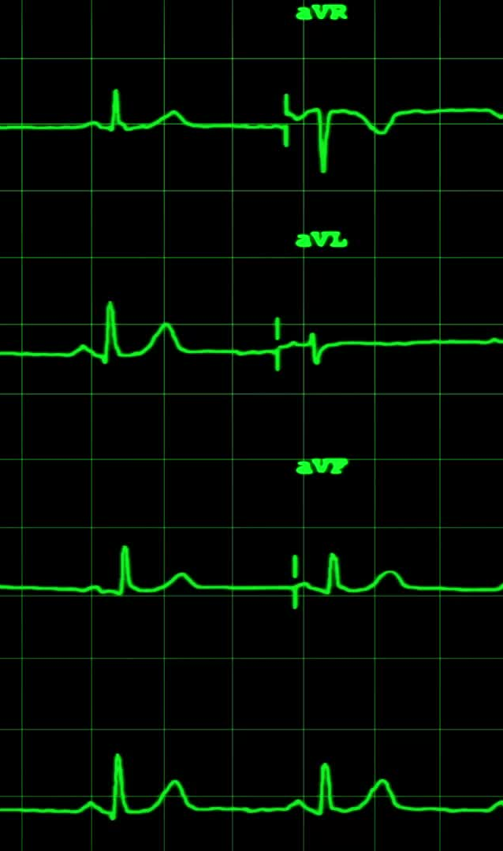
Feature Correlation Details
MLS_BEDS (Correlation: 0.1867): Positive correlation: As the number of bedrooms (MLS_BEDS) increases, the PLAN_PRICE tends to increase, but the correlation is relatively weak.
MLS_BATHS (Correlation: 0.3437): Positive correlation: As the number of bathrooms (MLS_BATHS) increases, the PLAN_PRICE tends to increase. This correlation is moderate.
MLS_BATHS_TOTAL (Correlation: 0.4063): Positive correlation: The total number of bathrooms (MLS_BATHS_TOTAL) has a moderate positive correlation with PLAN_PRICE.
MLS_LISTING_PRICE (Correlation: 0.9071): Strong positive correlation: The listing price in the MLS (MLS_LISTING_PRICE) has a very strong positive correlation with PLAN_PRICE. This indicates that there is a high linear relationship between the two.
MLS_PRIOR_LISTING_PRICE_TRANX (Correlation: 0.0281): The prior listing price (MLS_PRIOR_LISTING_PRICE_TRANX) has a weak positive correlation with PLAN_PRICE. It means there is a minor increase in PLAN_PRICE as the prior listing price increases.
MLS_DAYS_ON_MARKET (Correlation: -0.0234): The number of days a property is on the market (MLS_DAYS_ON_MARKET) has a weak negative correlation with PLAN_PRICE. This suggests that, on average, properties with longer days on the market have slightly lower plan prices.
MLS_LONGITUDE (Correlation: -0.2738): Moderate negative correlation: The longitude of the property (MLS_LONGITUDE) has a moderate negative correlation with PLAN_PRICE. This indicates that properties located farther west have lower plan prices.
MLS_LATITUDE (Correlation: 0.1869): Positive correlation: The latitude of the property (MLS_LATITUDE) has a positive correlation with PLAN_PRICE. Properties located farther north tend to have higher plan prices.
MLS_YEAR_BUILT (Correlation: -0.0054): Very weak negative correlation: The year the property was built (MLS_YEAR_BUILT) has a very weak negative correlation with PLAN_PRICE. It suggests that newer properties may have slightly lower plan prices, but the relationship is minimal.
MLS_SQUARE_FOOTAGE (Correlation: 0.4242): Moderate positive correlation: The square footage of the property (MLS_SQUARE_FOOTAGE) has a moderate positive correlation with PLAN_PRICE. Larger properties tend to have higher plan prices.

Slide 9

Machine Learning Model Performance
Mean Squared Error (MSE): 1.0376E09
Root Mean Squared Error (RMSE): 32213.2952
Mean Absolute Error (MAE): 18382.9744
R-squared (R2): 0.9682
Explained Variance Score: 0.9682
Mean Absolute Percentage Error (MAPE): 0.0386
Mean Squared Logarithmic Error (MSLE): 0.0036

Slide 10
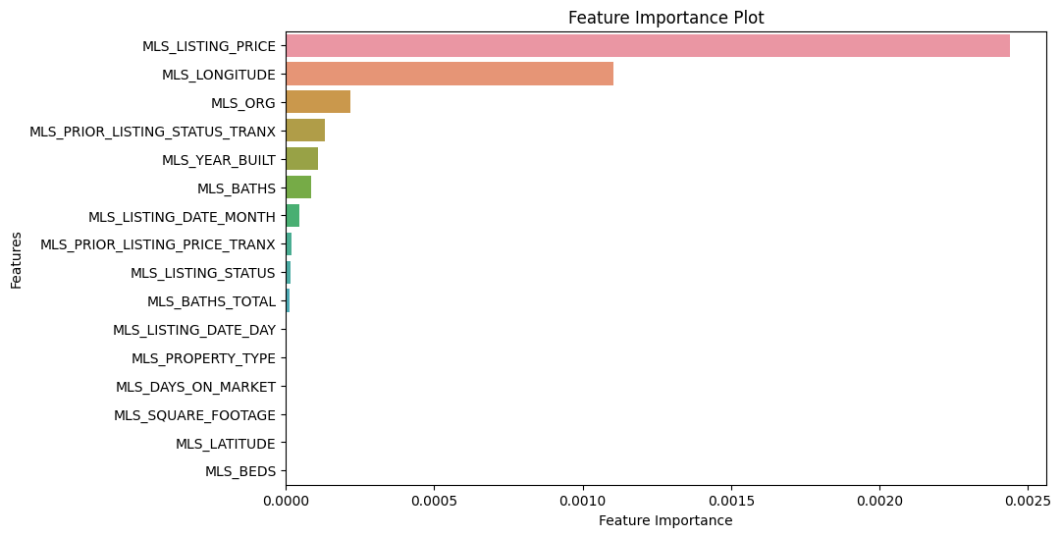
Feature Importance

Slide 11
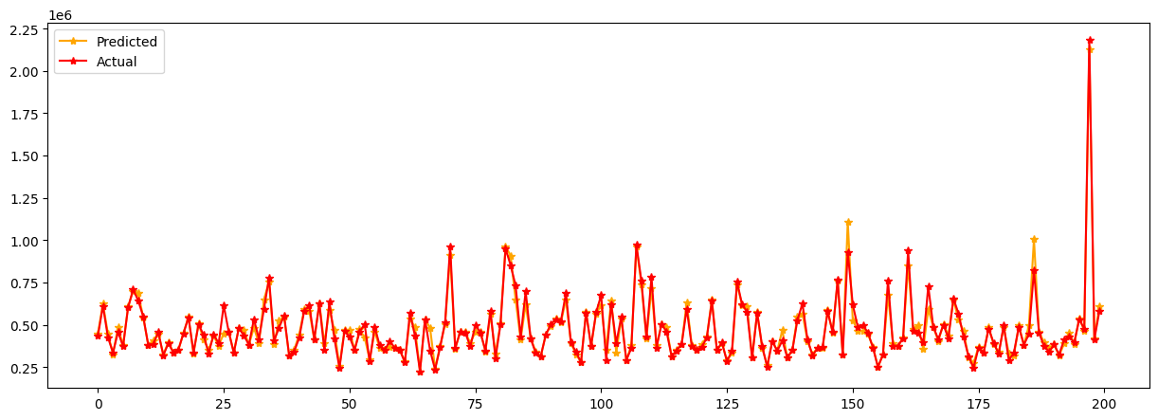
Actual vs Predicted Plan Price Comparison

Slide 12

Thanks

